Slide 1
DESIGN AND ANALYSIS OF ALGORITHMS
MODULE1

Slide 2
INTRODUCTION
Informal Definition:
An Algorithm is any well-defined computational procedure that takes some value or set of values as input and produces a set of values or some value as output.
Algorithm is a sequence of computational steps that transforms the input into the output

Slide 3
Formal Definition:
An algorithm is a sequence of unambiguous instructions for solving a problem, i.e. , for obtaining a required output for any legitimate input in a finite amount of time.

Slide 4
All algorithms should satisfy the following criteria or properties.
1.INPUT →Zero or more quantities are externally supplied.
2.OUTPUT →At least one quantity is produced.
3.DEFINITENESS → Each instruction is clear and unambiguous.
4.FINITENESS → If we trace out the instructions of an algorithm , then for all cases, the algorithm terminates after a finite number of steps.
5.EFFECTIVENESS → Every instruction must very basic so that it can be carried out, in principle , by a person using only pencil& paper.
Should not contain any unnecessary steps.

Slide 5
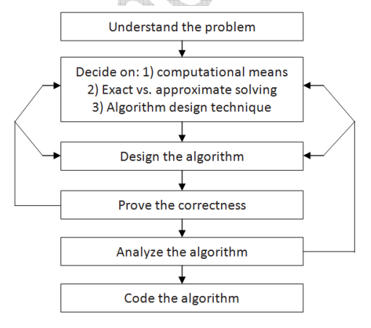
Fundamentals Of Algorithmic Problem Solving

Slide 6
UNDERSTANDING THE PROBLEM
Before designing an algorithm the most important thing is to understand the problem given.
Read the problem’s description carefully to understand the problem statement completely.
Ask questions for clarifying the doubts about the problem.
Identify the problem types and use existing algorithm to find solution.
Input (instance) to the problem and range of the input get fixed.

Slide 7
Decision making
The Decision making is done on the following:
a) Ascertaining the Capabilities of the Computational Device
b) Choosing between Exact and Approximate Problem Solving:
C) Algorithm Design Techniques

Slide 8
Ascertaining the capabilities of a computational device
After understanding need to ascertain the capabilities of the device.
The vast majority of algorithms in use today are still destined to be programmed for a computer closely resembling the von Neumann machine—a computer architecture.
Von Neumann architectures are sequential and the algorithms implemented on them are called sequential algorithms.
Algorithms which designed to be executed on parallel computers called parallel algorithms.

Slide 9
EXACT OR APPROXIMATE
The next principal decision is to choose between solving the problem exactly or solving it approximately.
An algorithm used to solve the problem exactly and produce correct result is called an exact algorithm.
If the problem is so complex and not able to get exact solution, then we have to choose an algorithm called an approximation algorithm. i.e., produces an
Approximate answer. E.g., extracting square roots, solving nonlinea equations,and evaluating definite integrals.

Slide 10
Choosing between exact and approximate problem solving
For exact result->exact algorithm
For approximate result->approximation algorithm.
Examples of exact algorithms: Obtaining square roots for numbers and solving non linear equations.
An approximation algorithm can be a part of a more sophisticated algorithm that solves a problem exactly

Slide 11
Deciding on appropriate data structures
Algorithms may or may not demand ingenuity in representing their inputs.
Inputs are represented using various data structures.
Algorithm +data structures =program.
Though Algorithms and Data Structures are independent, but they are
combined together to develop program. Hence the choice of proper data
structure is required before designing the algorithm.

Slide 12
Algorithm Design Techniques and Methods of Specifying an Algorithm
An algorithm design technique(or―strategy‖or―paradigm‖)is a general approach to solving problems algorithmically that is applicable to a variety of problems from different areas of computing.
The different algorithm design techniques are: brute force approach , divide and conquer ,greedy method , decrease and conquer , dynamic programming, transform and conquer and backtracking.

Slide 13
Methods of specifying an algorithm : Using natural language,in this method ambiguity problem will be there.
The next 2 options are: pseudocode and flowchart.
Pseudocode :mix of natural and programming language. More precise than NL Flowchart : method of expressing an algorithm by collection of connected geometric shapes containing descriptions of the algorithm‘s steps. This representation technique has proved to be inconvenient for large problems

Slide 14
Proving an Algorithm’s Correctness
After specifying an algorithm we have to prove its correctness.
The correctness is to prove that the algorithm yields a required result for every legitimate input in a finite amount of time.
For some algorithms , a proof of correctness is quite easy ; for others , it can be quite complex. A common technique for proving correctness is to use mathematical induction. Proof by mathematical induction is most appropriate for proving the correctness of an algorithm.

Slide 15
Analyzing an algorithm
After correctness , efficiency has to be estimated.
Time efficiency and space efficiency.
Time : how fast the algorithm runs?
Space : how much extra memory the algorithm needs?
Simplicity : how simpler it is compared to existing algorithms .

Slide 16
Code the algorithm
Writing program by using programming language.

Slide 17
Algorithm Specification
Algorithm can be described in three ways
1.Natural language like English
2.Graphic representation called flowchart :
3.Pseudo-codeMethod:

Slide 18
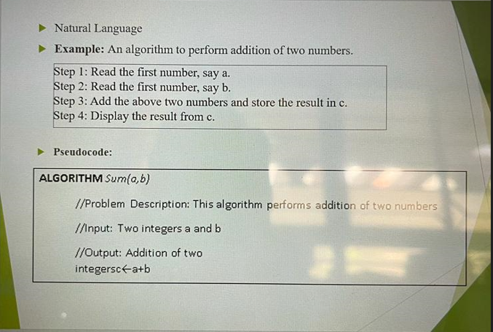

Slide 19
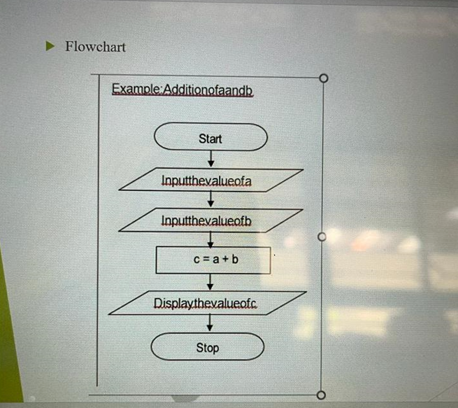

Slide 20
Pseudo-Code Conventions:
1.Comments begin with//and continue until the end of line.
2.Bocks are indicated with matching braces {and}.
3. An identifier begins with a letter .The data types of variables are not explicitly declared.
4.Compound data types can be formed with records.
5.Assignment of values to variables is done using the assignment statement. :=; 6.
There are two Boolean values TRUE and FALSE.
✓Logical Operators AND,OR,NOT

Slide 21
PERFORMANCE ANALYSIS
Space complexity :
Total amount of computer memory required by an algorithm to complete its execution is called as space complexity of that algorithm. The Space required by an algorithm is the sum of following components.
A fixed part that is independent of the input and output . This includes memory space for codes, variables , constants and so on.
A variable part that depends on the input, output and recursion stack.
Space requirement S(P) of an algorithm P,
S(P)= c + Sp
Where c is a constant depends on the fixed part , Sp is the instance characteristics.

Slide 22
float abc(float a , float b , float c)
{
return (a + b + b * c + (a+b+c)/(a+b) +4.0);
}

Slide 23
Here fixed component depends on the size of a , b and c.
Also instance characteristics Sp=0

Slide 24
Time Complexity
The time T(p) taken by a program P is the sum of the compile time and the run time(execution time) .
tp→ sum of the time taken to execute all the instructions in the program.
For estimation of time complexity →count only the number of program steps.

Slide 25
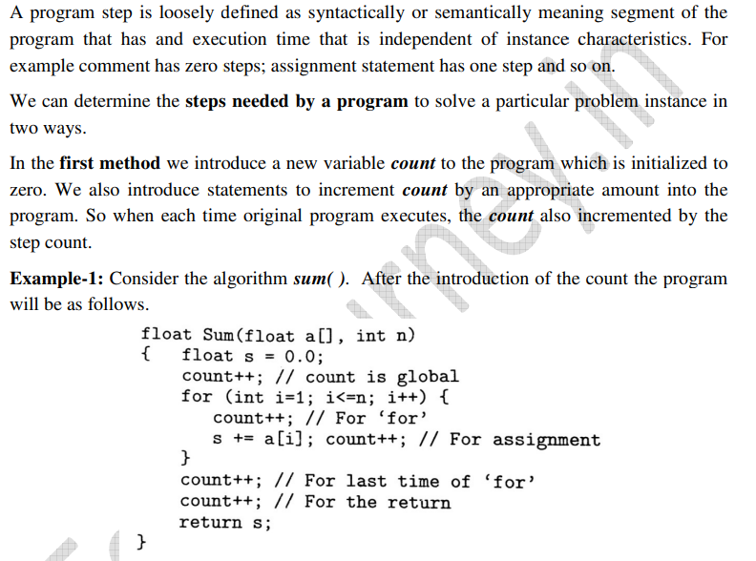

Slide 26
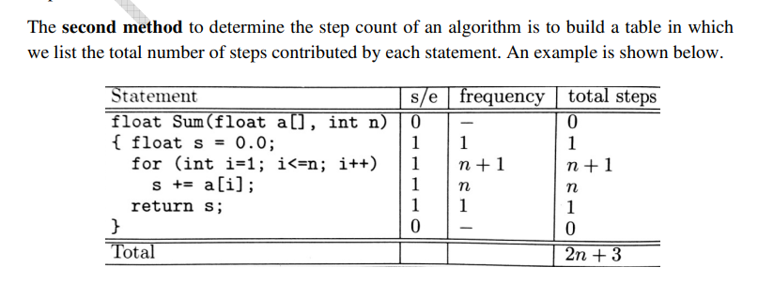

Slide 27
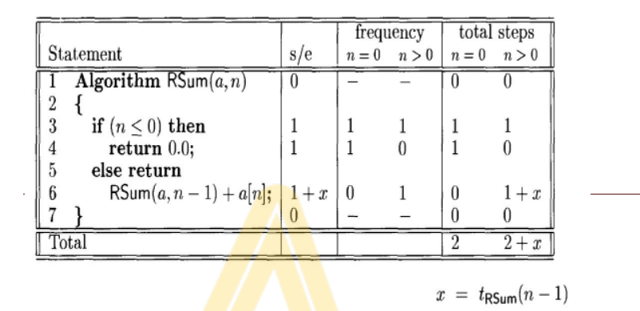

Slide 28
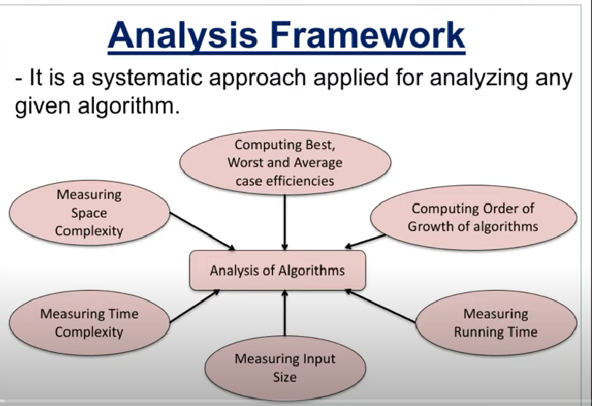

Slide 29
1)Measuring Space complexity
2)Measuring Time complexity

Slide 30
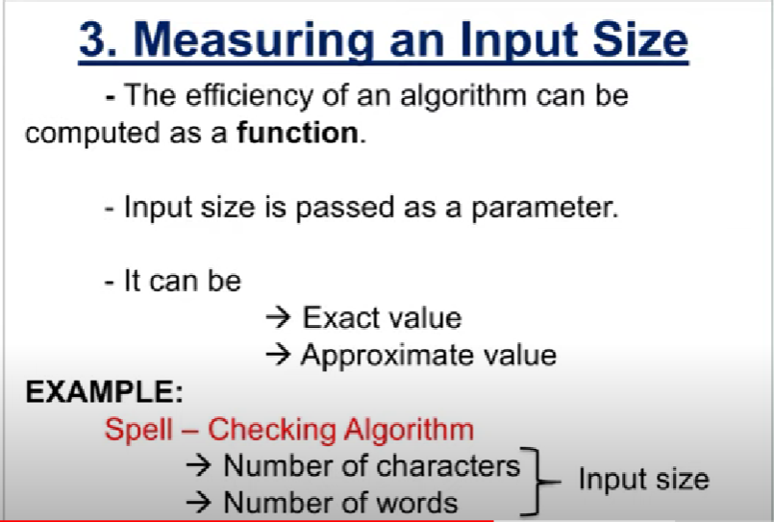

Slide 31
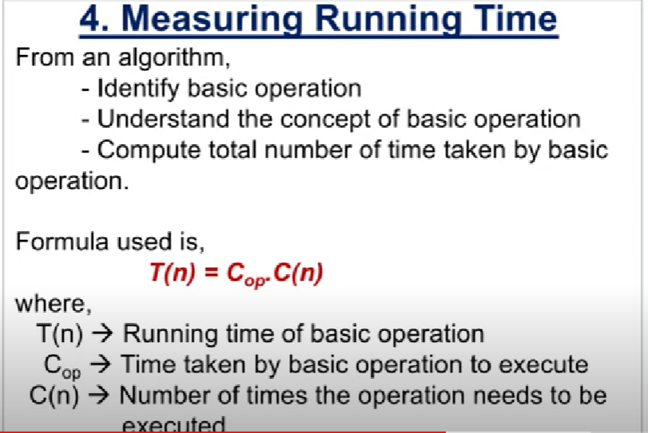

Slide 32
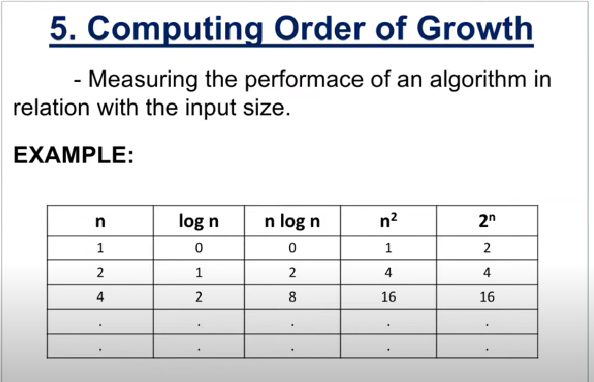

Slide 33
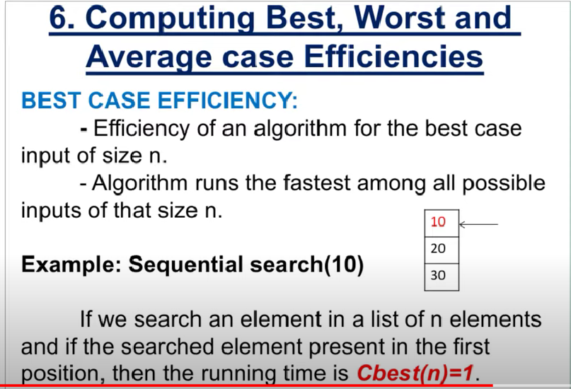

Slide 34
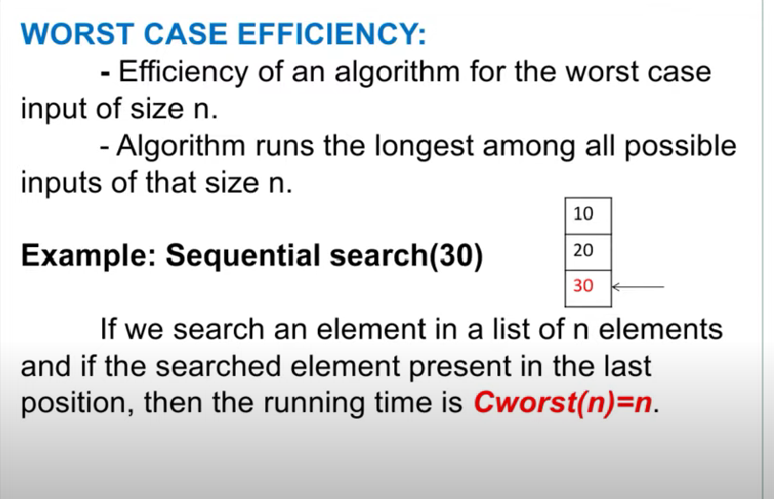

Slide 35
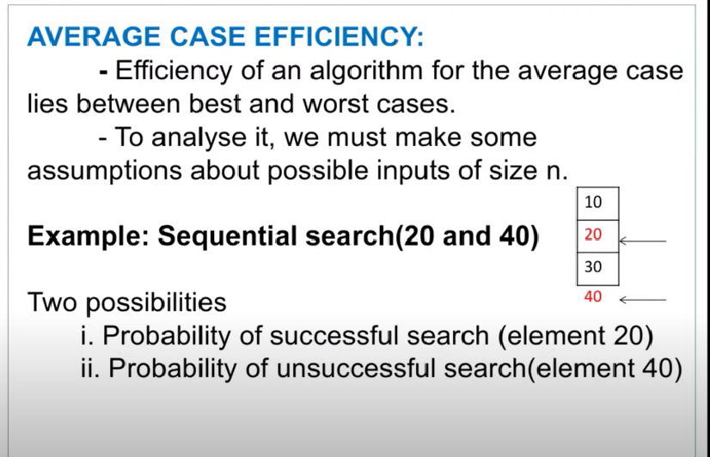

Slide 36
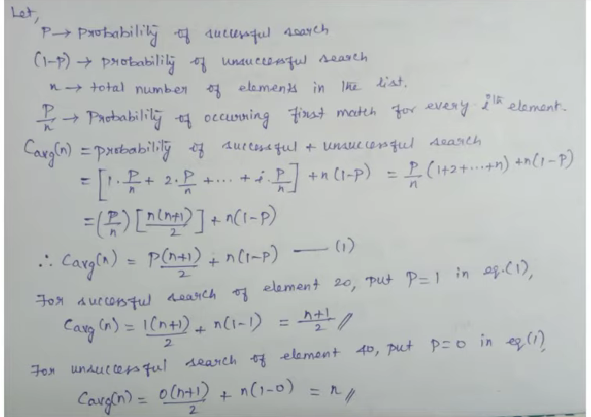

Slide 37
ASYMPTOTIC NOTATIONS
O(Big-oh)
Ω(Big-omega),
Θ(Big-theta)

Slide 38
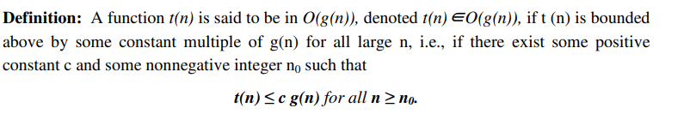
Big-Oh (O)

Slide 39
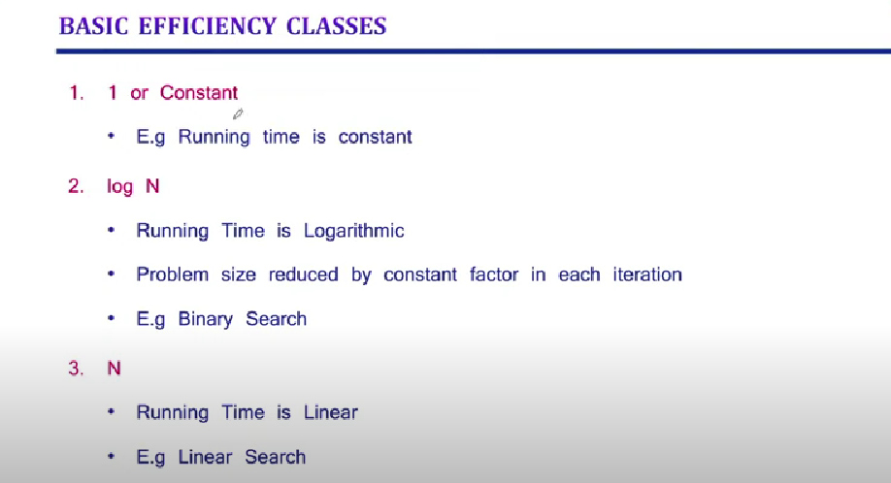

Slide 40
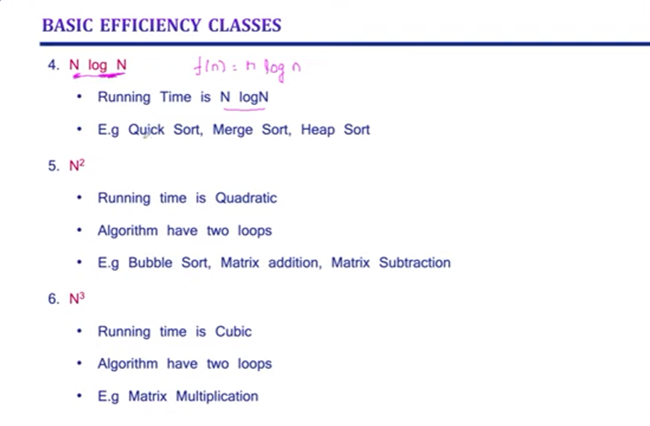

Slide 41
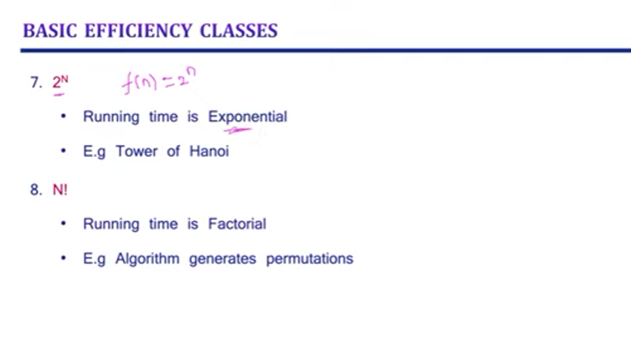

Slide 42
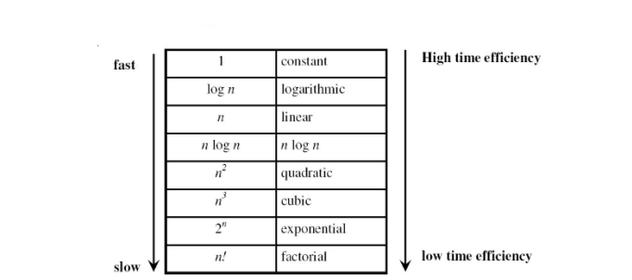

Slide 43
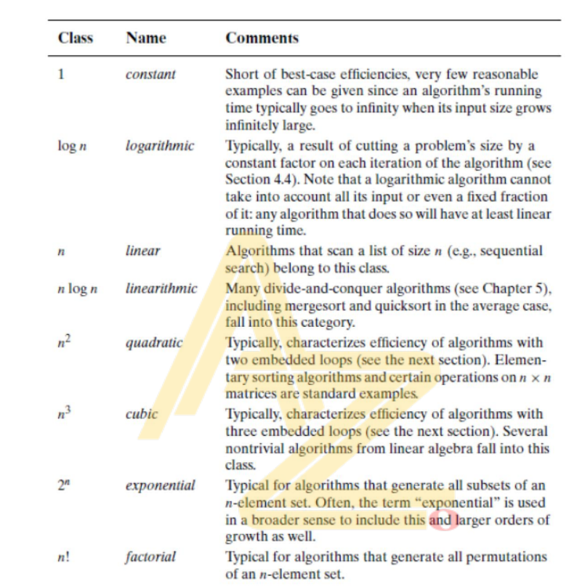

Slide 44
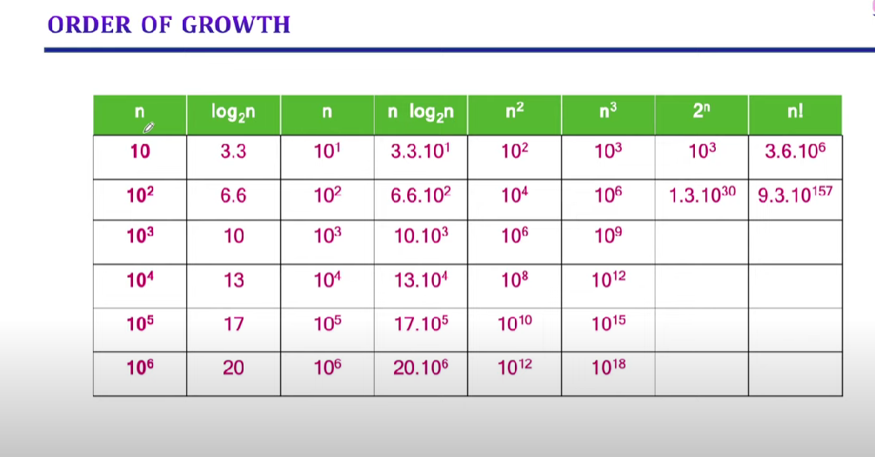

Slide 45
MATHEMATICAL ANALYSIS OF NON-RECURSIVE ALGORITHMS
General plan for analyzing efficiency of non-recursive algorithms:
1.Decide on parameter n indicating the input size of the algorithm.
2.Identify algorithm‘s basic operation.
3.Check whether the number of times the basic operation is executed depends only on the input size n. If it also depends on the type of input,then investigate worst,average, and best case efficiency separately.
4.Set up summation for C(n) reflecting the number of times the algorithm‘s basic operation is executed.
5.Simplify summation using standard formula

Slide 46
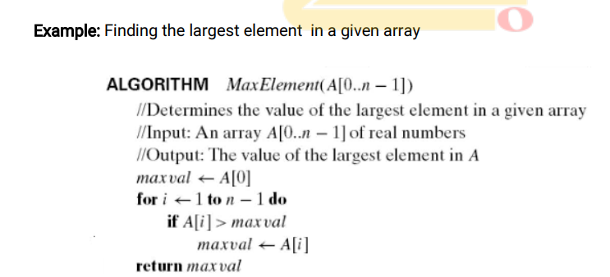

Slide 47
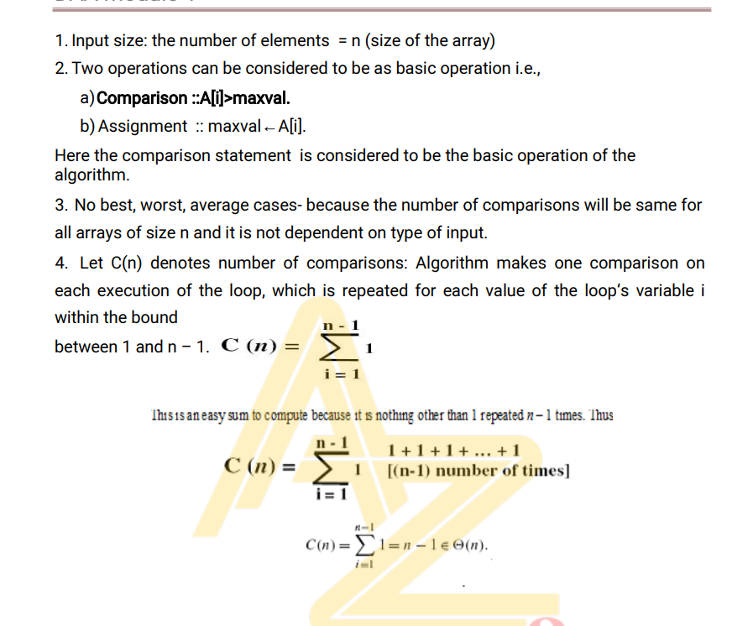

Slide 48
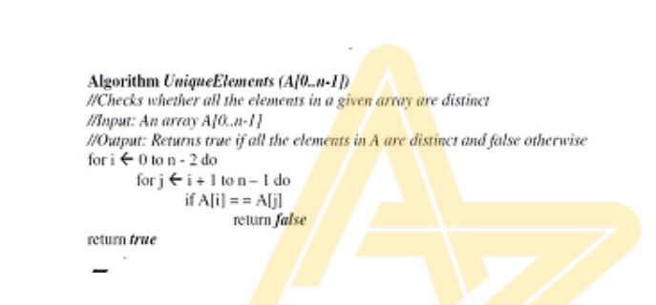

Slide 49
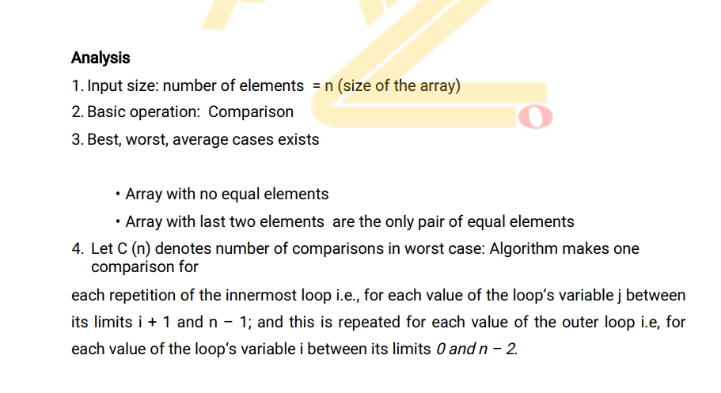

Slide 50
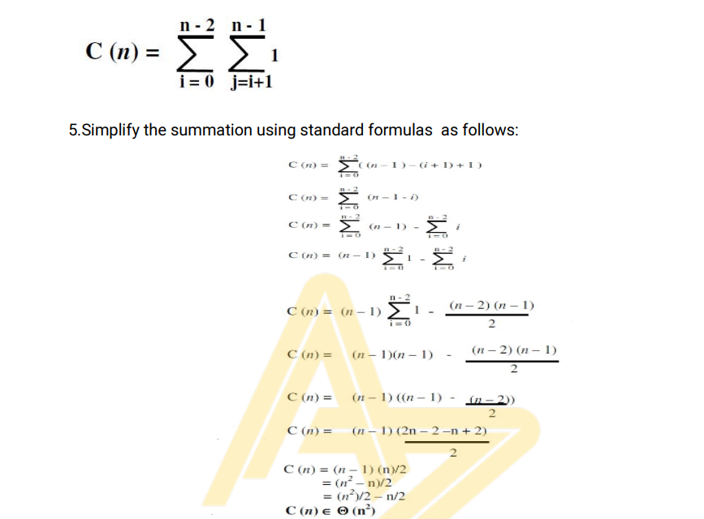

Slide 51
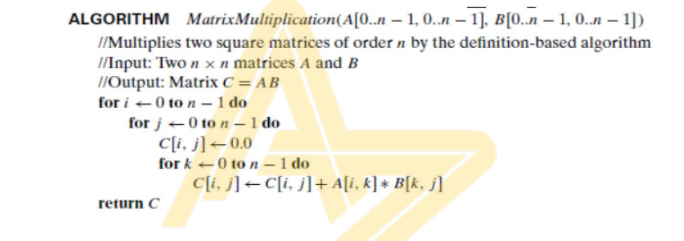

Slide 52
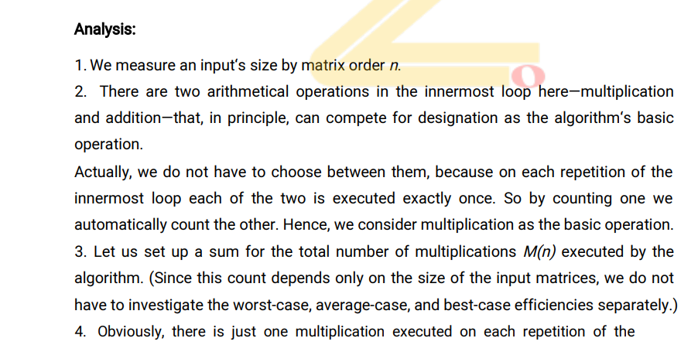

Slide 53
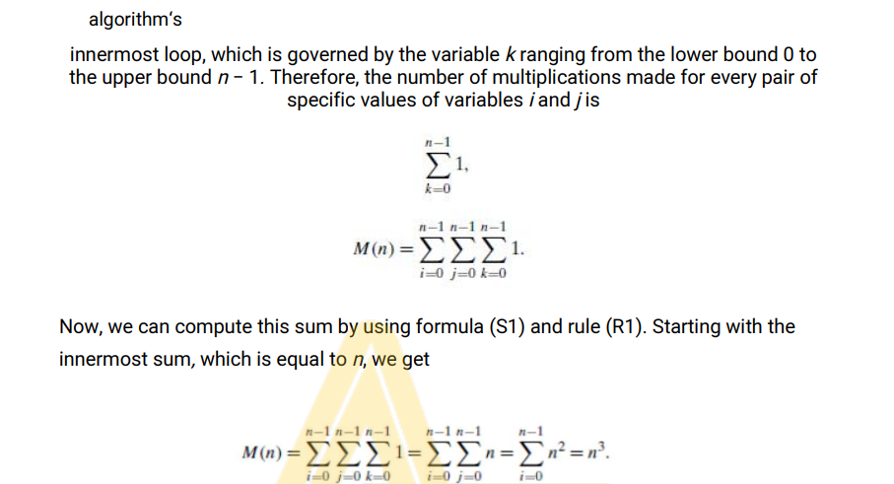

Slide 54
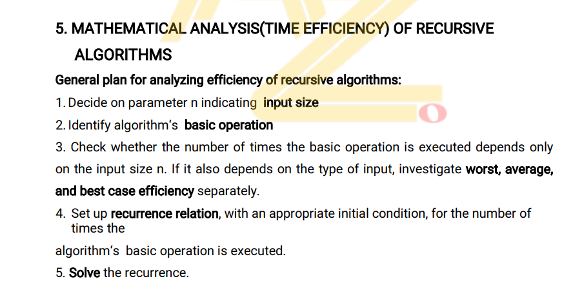

Slide 55
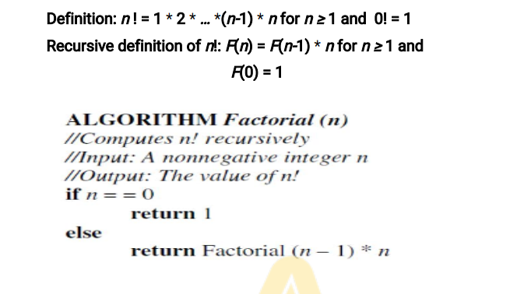

Slide 56
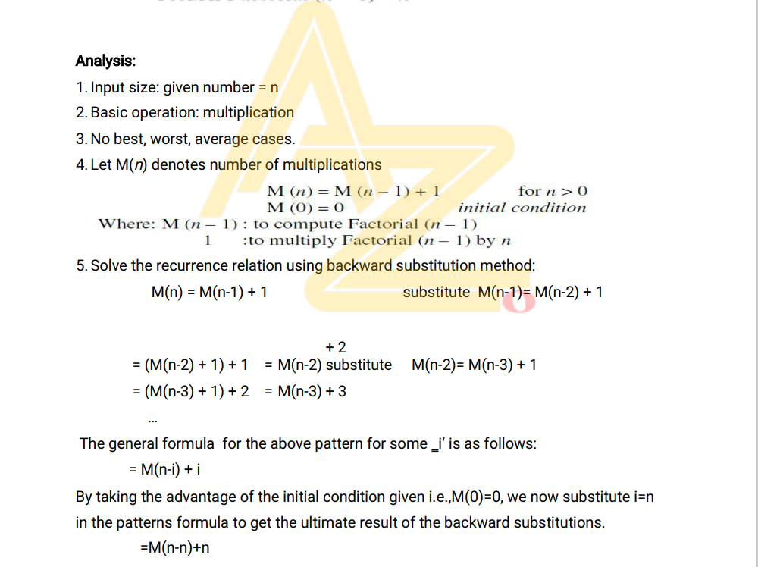

Slide 57
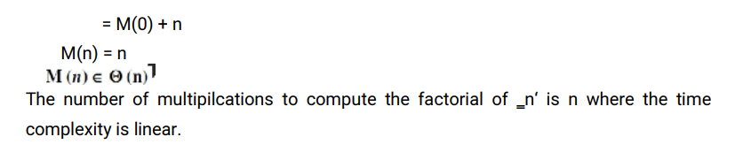

Slide 58
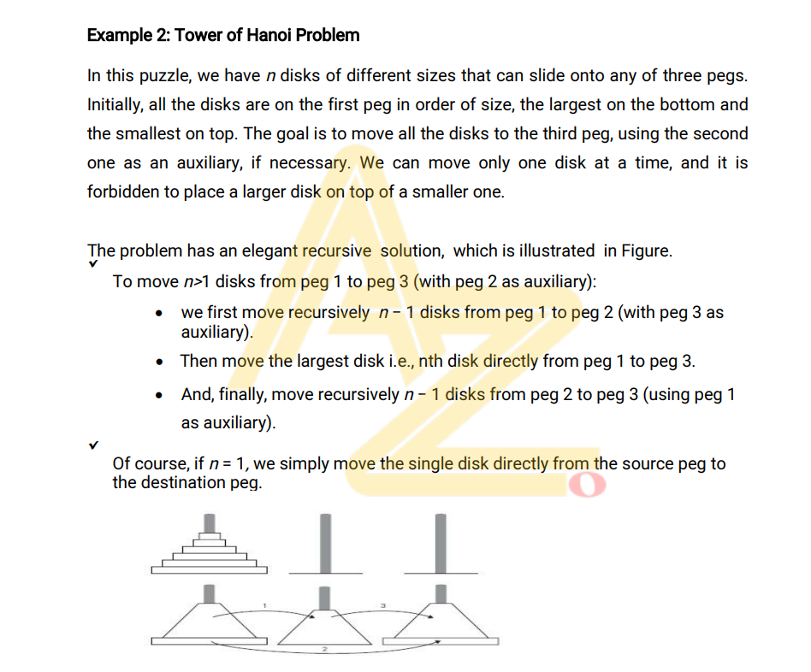

Slide 59
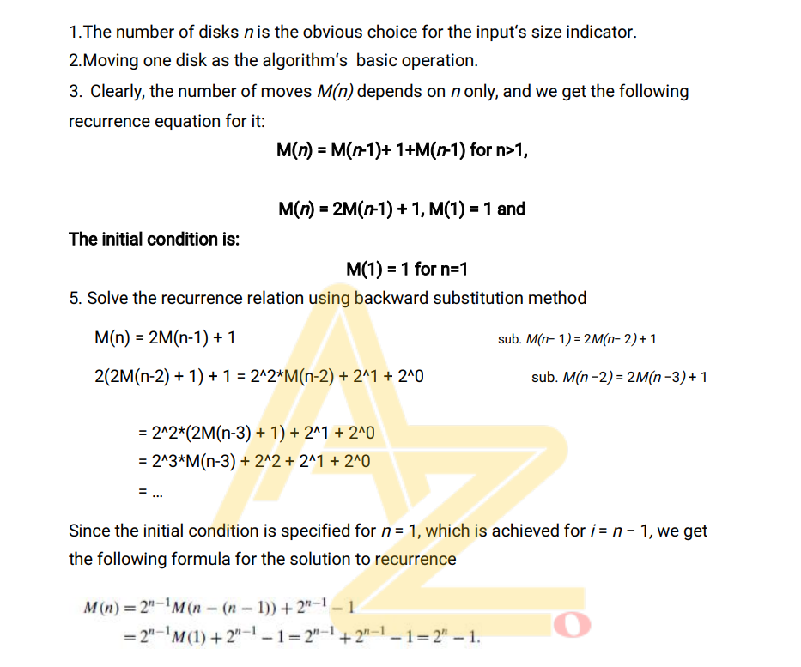

Slide 60
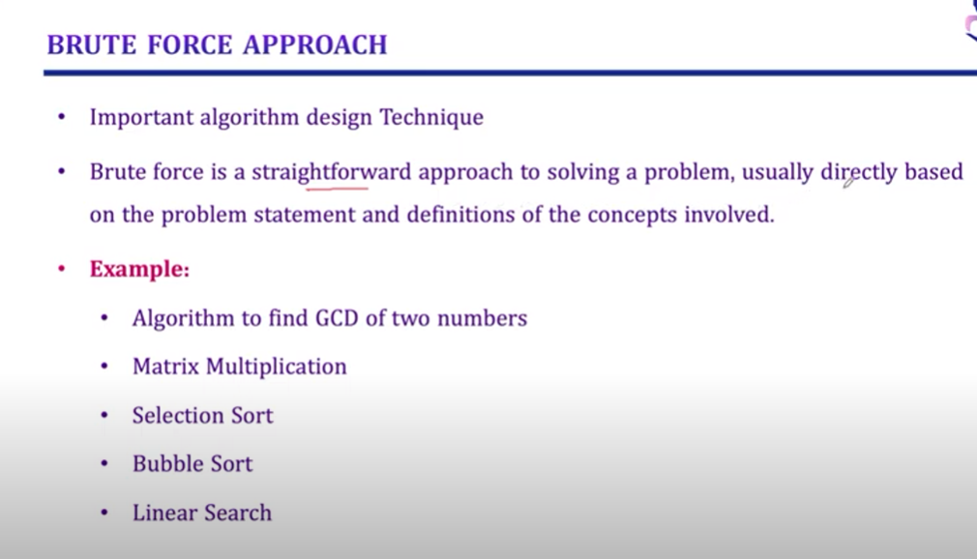

Slide 61
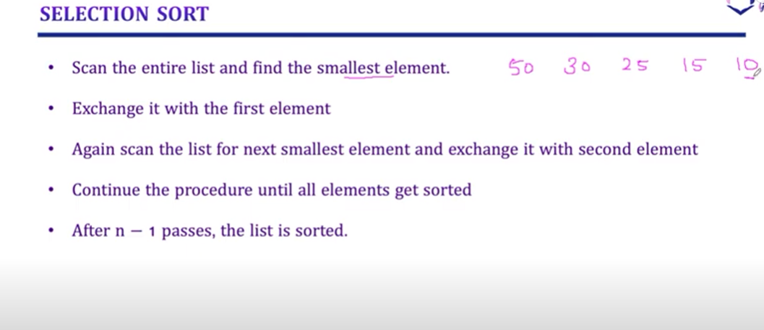

Slide 62
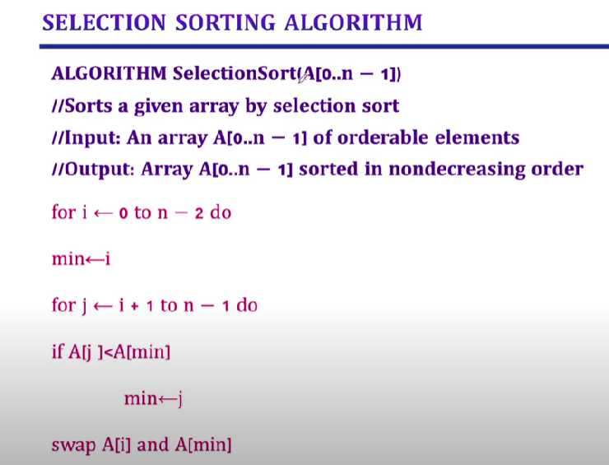

Slide 63
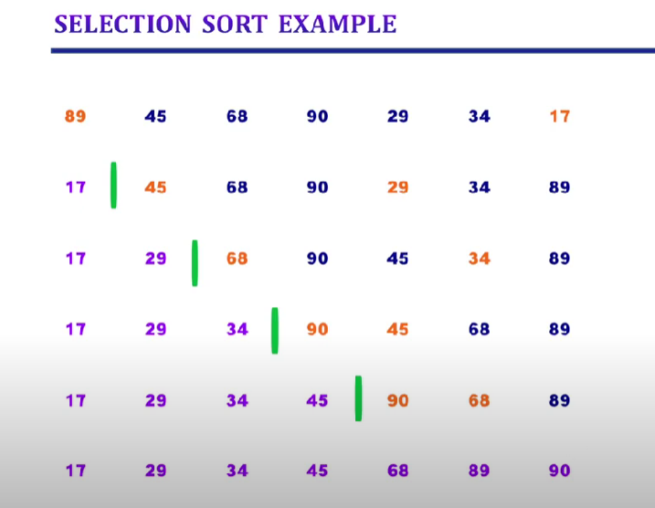

Slide 64
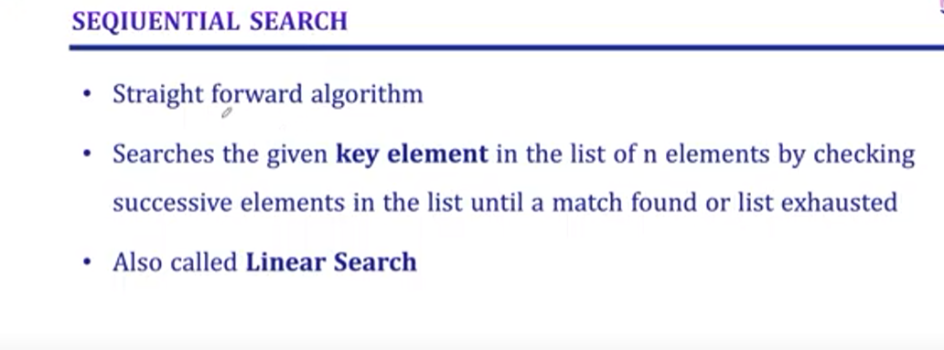

Slide 65
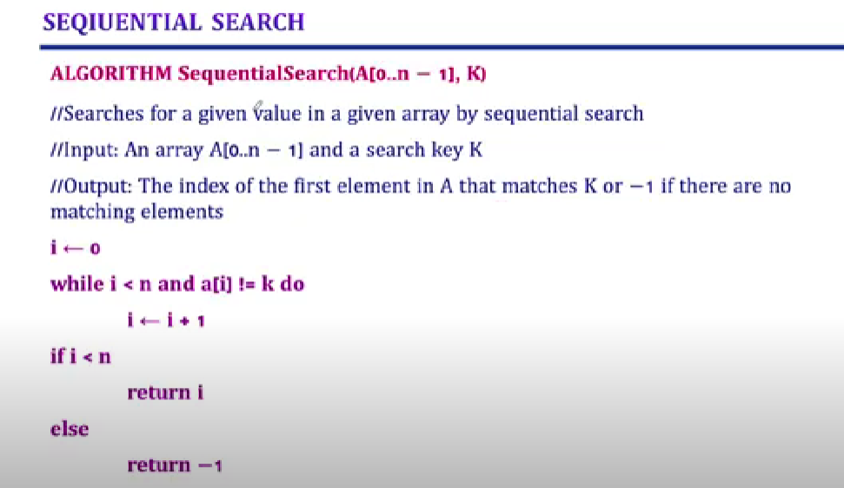

Slide 66
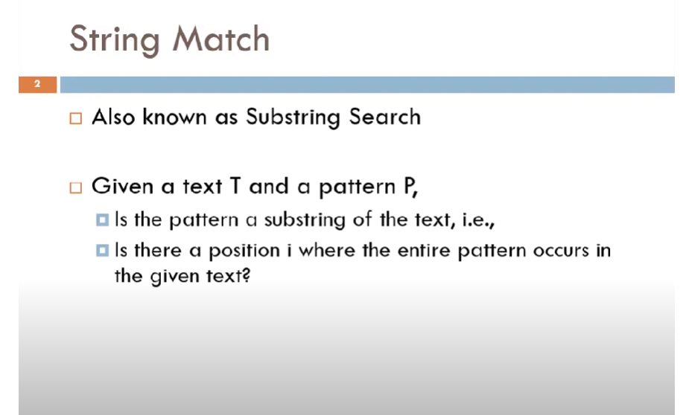

Slide 67
